Slide 1
Sales Performance Dashboard
Tools Used
Power BI
DAX
Microsoft Excel (CSV)
Submitted by: Aniket Kumar Gupta

Slide 2
Objective
The objective of this project is to design an interactive sales dashboard that helps business stakeholders monitor sales performance and make data-driven decisions.
Dataset Includes
Sales Amount
Product Category
Region
Sales Representative
Customer Type
Payment Method
Sales Channel
Quantity Sold
Discount
Sale Date

Slide 3
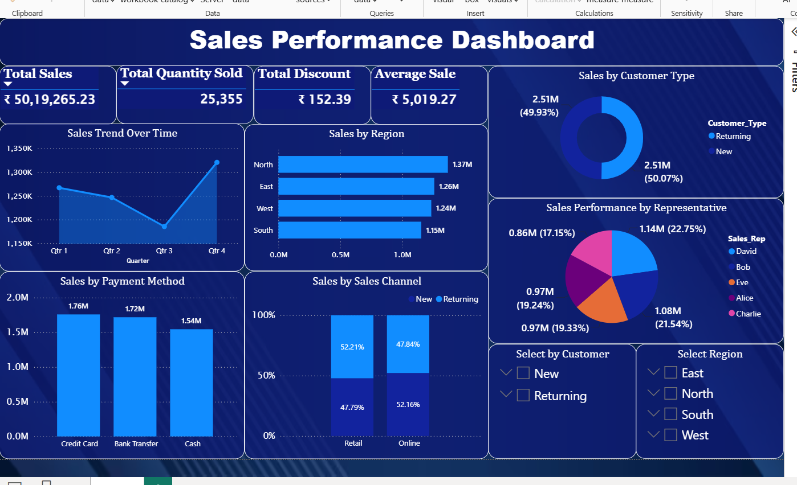
KPIs
Visualizations
Total Sales
Total Quantity Sold
Total Discount
Average Sale
Sales Trend Over Time
Sales by Region
Sales by Customer Type
Sales by Payment Method
Sales by Sales Representative
Sales by Sales Channel

Slide 4
Based on the dashboard:
Total Sales exceeded 5 million.
North region generated the highest sales.
New and Returning customers contributed almost equally to total sales.
Credit Card was the most preferred payment method.
Retail and Online sales channels showed similar performance.
Sales representatives contributed differently, helping identify top performers.

Slide 5
Technical Skills
Business Skills
KPI Analysis
Sales Trend Analysis
Regional Performance Analysis
Customer Behaviour Analysis
Power BI Dashboard Design
Data Modelling
DAX Measures
Data Cleaning
MySQL
Data Visualization
Interactive Slicers

Slide 6
Conclusion
This dashboard provides a clear overview of business performance through interactive visualizations and KPIs. It enables stakeholders to analyse sales trends, compare regional performance, understand customer behaviour, and make informed business decisions.

